Slide 1

Football Manager AI Assistant Data-Driven Player Scouting & Tactical Recommendation System
School of Computer Science and Engineering
Department of Computer Science and Engineering
Submitted By: Tanmay Singh
2427030035
Supervised By: Dr. Akshay Jadhav

Slide 2






OVERVIEW
Outline
01
Introduction
04
Objectives
Background, motivation & industry context
4 goals of the Football Manager AI system
02
Literature Review
05
Proposed Methodology
10 related research papers & prior work
Layered architecture, features, AutoML pipeline
03
Problem Statement
06
Results & Outcome
The core challenge this project addresses
Model comparison, AI Score, working prototype
2

Slide 3




INTRODUCTION 1/2
Introduction
Football clubs generate massive amounts of player data every season — yet most decision-making still relies on manual scouting. This project uses machine learning to turn raw statistics into actionable player ratings.
The Problem with Traditional Scouting
Manual observation and basic stats (goals, assists) are subjective and miss critical contributions like progression, creativity, and defensive work.
Why Machine Learning?
ML can process large datasets, detect hidden patterns, and generate consistent scores — removing human bias from player evaluation.
What This System Does
Applies domain-specific feature engineering and an AutoML-style pipeline to generate an AI Score (0–99) for every player in the dataset.
Who Benefits?
Small clubs and analysts who cannot afford commercial tools like Opta or SciSports can use this open, data-driven alternative.
3

Slide 4
INTRODUCTION 2/2
Industry Context — Real-World AI in Football
Application | Description | Model / Tech | Limitation
Opta Sports | xG, xA, tracking data for professional clubs | ML + Statistical Models | Expensive paid access
Transfermarkt | Estimates player market value from performance | Algorithm + ML Regression | Not transparent method
SciSports BallJames | AI-based video tracking for tactical analysis | Deep Learning + CV | Requires HD cameras
Man City Fan Labs | AI for fan analytics and decision support | Predictive Analytics | Limited to fan data
Barça Innovation Hub | Heatmaps, passing networks for tactical evaluation | ML + Computer Vision | Not publicly available
↳ This project provides a free, open alternative using publicly available FBref-style statistics.
4

Slide 5
LITERATURE REVIEW 1/2
Research Papers Overview
# | Title | Model | Key Result
1 | Predicting Football Player Performance Using ML (2023) | RF, XGBoost | R² ≈ 0.87; RF performs best
2 | Market Value Prediction of Football Players (2023) | Random Forest | R² ≈ 0.90
3 | ML Applications in Soccer – Systematic Review (2022) | SVM, RF, ANN | ML enhances scouting reliability
4 | Bayesian Player Value Model (2022) | Bayesian Ensemble | Low RMSE; needs clean data
5 | ML Modeling to Evaluate Football Player Value (2022) | Random Forest | Strong accuracy on shots & duels
5

Slide 6
LITERATURE REVIEW 2/2
Research Papers Overview (continued)
# | Title | Model | Key Result
6 | PlayeRank: Data-Driven Player Ranking in Soccer (2018) | ML + Scoring | Accurate position-aware rankings
7 | Football Performance Prediction (2021) | ANN | High accuracy; heavy training time
8 | Neural Network Player Performance Prediction (2020) | ANN | High performance; overfitting risk
9 | Forecasting Player Development and Value (2025) | Regression + ML | Good future prediction; early instability
10 | Soccer Match Outcome Prediction Using ML (2021) | SVM, RF | 75–80% accuracy on match results
Research Gap: No existing open system combines FBref feature engineering + AutoML model selection + integrated scouting modules.
6

Slide 7
PROBLEM STATEMENT
Problem Statement
Small football clubs and independent analysts lack an integrated, data-driven system that combines player scouting and squad analysis into a single decision-support platform — one that is objective, automated, and accessible without expensive commercial tools.
Current Scenario
Need for Solution
Manual scouting is time-consuming and subjective
Automated, objective player scoring using ML
Basic stats miss critical contributions
Domain-specific features that reflect real performance
No single tool integrates search + analysis
Integrated platform: search, compare, build, analyse
Commercial tools inaccessible for small clubs
Open system built on publicly available FBref-style data
7

Slide 8

OBJECTIVES
Project Objectives
01
Engineer Domain-Specific Features
Extract 10+ meaningful metrics (Finishing Quality, Creativity, Defensive Actions, Ball Progression, etc.) using an FBref-inspired feature engineering pipeline.
02
Intelligent Player Search
Develop a keyword-based search system that ranks players by AI Score, with position-aware filtering for targeted scouting.
03
Build Predictive Models — AutoML Style
Train 8 ML models (Linear, Ridge, Lasso, Decision Tree, Random Forest, Gradient Boosting, SVR, Neural Network) and auto-select the best one.
04
Create Squad Analysis & Tactical Tools
Quantify team strength across Attack, Creativity, Defense, and Discipline dimensions and provide balance recommendations.
8

Slide 9

METHODOLOGY 1/5
Proposed Methodology — System Architecture
● Dataset (3000+ FBref-style player records)
DATA LAYER
● Preprocessing — missing value imputation, Min-Max normalization
● Feature Engineering — 7 derived domain-specific metrics
FEATURE LAYER
● Normalization — all features scaled 0–100 for consistency
● Model Training — 8 models trained (AutoML-style pipeline)
ML LAYER
● Model Comparison — R², RMSE, MAE evaluated
● Model Selection — best model chosen automatically
APPLICATION LAYER
● Player Search • Player Comparison • Squad Builder • Squad Analysis
9

Slide 10

Proposed Methodology — System Flowchart
1
2
3
4
Dataset
Preprocessing
Feature Engineering
Model Training
3000+ FBref-style
player records
Clean missing values
Min-Max normalize
Derive custom
performance features
8 models trained
(AutoML-style)
5
6
7
8
Model Selection
AI Score (0–99)
Player Search
Squad Analysis
Best model auto-
selected via R²/RMSE
Prediction normalized
to 0–99 scale
Ranked results by
AI Score
Attack / Creativity /
Defense scores
9

Slide 11
METHODOLOGY 2/5
Feature Engineering
About the Features
Feature | Formula | Role
Finishing Quality | Gls / (xG + 0.1) | Attack
Shot Efficiency | SoT / (Sh + 0.1) | Attack
Creativity | Ast + xAG + KP | Midfield
Defensive Actions | Tkl + Int + Blocks | Defense
Ball Progression | PrgP + PrgC + PrgR | All
Involvement | Touches | All
Discipline Penalty | CrdY + 2×CrdR | All
Derived domain-specific features
Raw stats alone cannot represent a player's true contribution. Features are computed from the base dataset.
Captures attack, creativity, defense
Features are grouped by role: offensive (Finishing Quality, Shot Efficiency), creative (Creativity), defensive (Defensive Actions), and general (Ball Progression, Involvement, Discipline).
Inspired by FBref & xG models
Feature design follows publicly available football analytics standards — particularly expected goals (xG) and progressive actions methodology.
Normalized for consistency
All features are Min-Max scaled to 0–100 so no single metric dominates. A constant 0.1 is added to denominators to prevent division by zero.
10

Slide 12
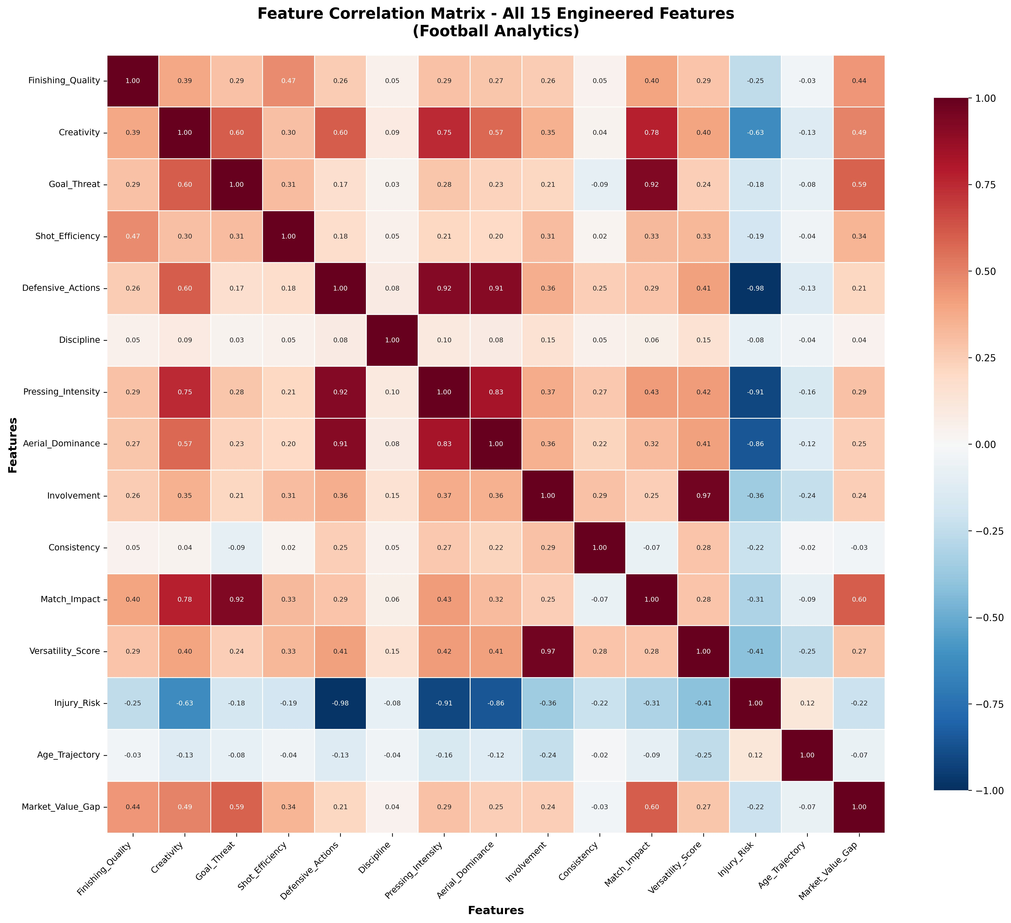
METHODOLOGY 3/5
Feature Correlation Analysis
Strong Predictors Identified
Defensive_Actions & Pressing_Intensity (r=0.92) confirm defensive features carry redundant info.
Multicollinearity Detected
Injury_Risk strongly inversely correlated with Defensive_Actions (r=−0.98) — useful for feature pruning.
Involvement ↔ Versatility
Involvement and Versatility_Score show r=0.97, indicating high overlap — one may be dropped.
Improves Model Reliability
Removing highly correlated redundant features reduces noise and improves prediction accuracy.
11

Slide 13
METHODOLOGY 4/5
Position-Based Scoring & Models Used
FW Forward
MF Midfielder
DF Defender
PRIMARY
PRIMARY
PRIMARY
● Finishing Quality
● Creativity
● Defensive Actions
● Shot Efficiency
● Ball Progression
● Discipline
● Goals (Gls)
● Involvement
● Blocks
SECONDARY
SECONDARY
SECONDARY
○ Assists
○ Assists
○ Tackles
○ xG
○ xAG
○ Interceptions
○ Creativity
○ Key Passes
○ PrgP
8 Models Trained (AutoML-Style)
Linear Regression
Ridge Regression
Lasso Regression
Decision Tree
Random Forest
Gradient Boosting
Support Vector Reg.
Neural Network (MLP)
12

Slide 14

METHODOLOGY 5/5
AutoML Workflow — Model Selection Logic
Instead of manually selecting one model, all 8 models are trained on the same dataset and evaluated using the same validation metrics. The best-performing model is then selected automatically.
1
2
3
4
5
Train All
8 Models
Evaluate
Each Model
Compare
Performance
Select
Best Model
Generate
AI Score
Each model trained on
engineered feature set
R², RMSE, MAE computed
on held-out data
Models ranked by
validation metrics
Highest R² / lowest
error model chosen
Best model predicts
AI Score (0–99)
Evaluation Metrics
R²
RMSE
MAE
Coefficient of Determination
Root Mean Squared Error
Mean Absolute Error
How much variance the model explains (higher = better)
Penalises large prediction errors more heavily
Average absolute gap between predicted & actual values
13

Slide 15
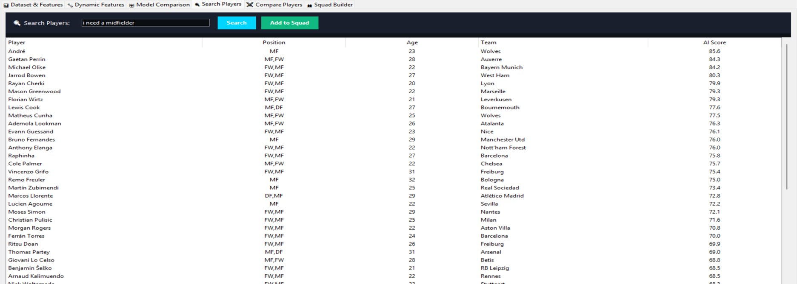
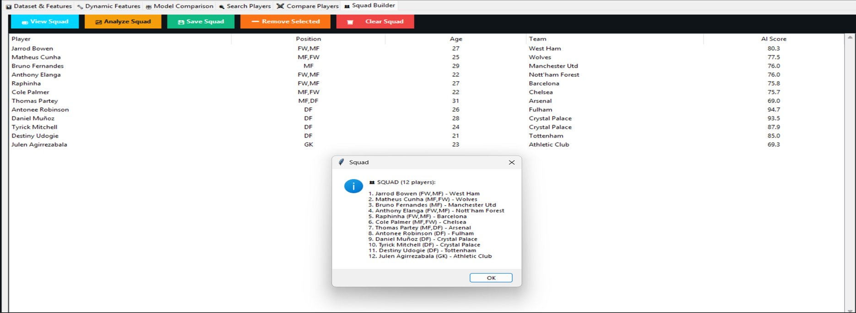
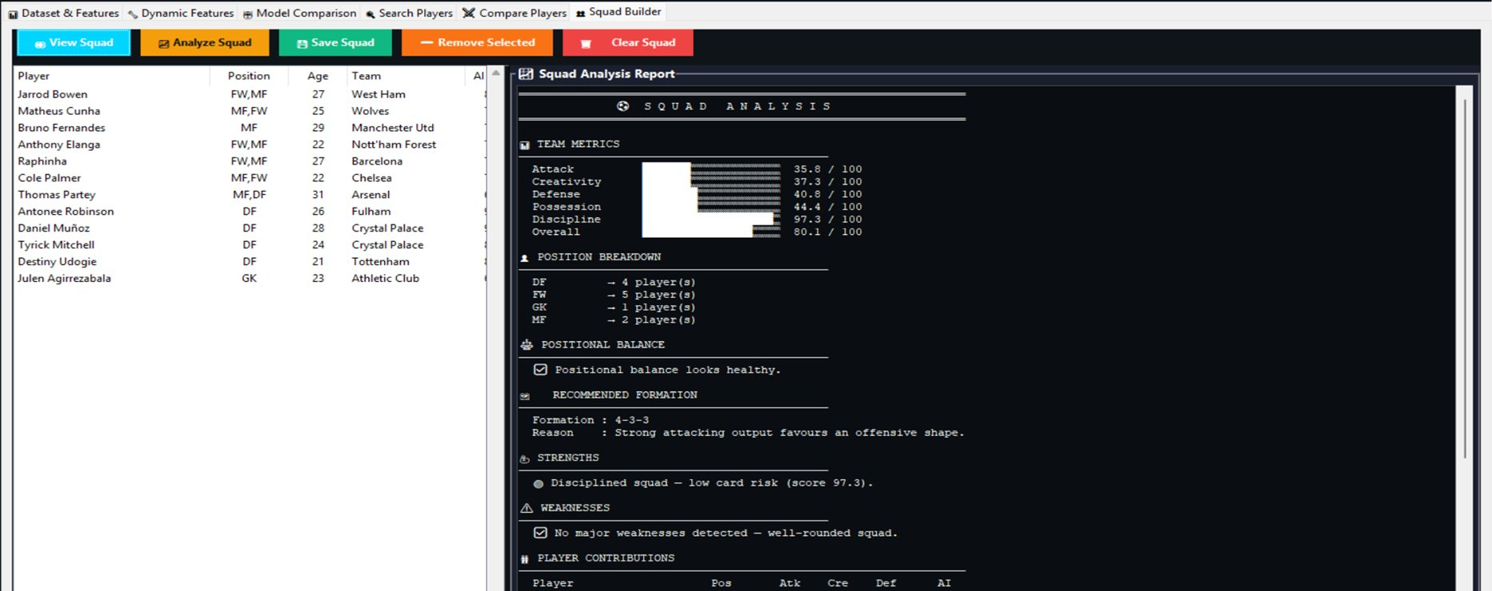
APPLICATION
Application Modules — Working System
Best Model
Selected
Prediction
Generated
Normalized
0–99
AI Score
Applied
Player Search Interface
Squad Builder Interface
Squad Analysis Dashboard
Natural language search — ranked by AI Score
Dynamic squad assembly with real AI Scores
Attack / Creativity / Defense metrics computed
14

Slide 16
RESULTS
Results
Best Models
Random Forest & Gradient Boosting showed the most stable R², RMSE, and MAE.
AutoML Result
Best model selected automatically — no manual tuning required.
AI Score (0–99)
Consistent, objective player ranking generated for 3000+ players.
Squad Analysis
Attack, Creativity, Defense, Discipline scores computed per squad.
Note: R² values are illustrative. Actual results depend on the final trained dataset.
15

Slide 17
OUTCOME
Outcome
Current status of the project and planned academic outcomes for next semester:
Functional AI-Based System Developed
Completed
A working local application built with Streamlit. Demonstrates the full pipeline from data loading to AI Score generation.
Multi-Model Comparison Implemented
Completed
All 8 models (Linear through Neural Network) trained and evaluated using R², RMSE, and MAE. AutoML selection is operational.
AI Score Prediction Working
Completed
AI Score (0–99) successfully generated for 3000+ players. Search, comparison, squad building, and analysis modules are functional.
Research Paper — Drafted
In Progress
Paper on AutoML-style model comparison for FBref-based player rating being prepared for student conference submission.
16

Slide 18

FUTURE WORK
Future Work
Current feature selection is performed manually. The following improvements are planned for the next development phase:
Automate Feature Selection Using ML
Replace manual feature design with data-driven selection using feature importance scores (e.g., from Random Forest) and SHAP values.
Improve Feature Importance Analysis
Analyse which engineered features contribute most to AI Score prediction and remove low-importance or highly correlated redundant features.
Enhance Prediction Accuracy
Incorporate additional data sources (match-level stats, opposition quality) and explore ensemble stacking to improve model R² further.
Real-Time Data Integration
Connect to a public football data API to keep player statistics current and allow live AI Score updates across all modules.
17

Slide 19
References
Real-World Applications
Opta Sports (StatsPerform)
Transfermarkt Player Valuation Method
Research Papers
SciSports (AI Scouting & Player Tracking)
Manchester City — City Fan Labs (AI Projects)
Predicting Football Player Performance Using ML (2023)
FC Barcelona — Barça Innovation Hub (AI in Sports)
Market Value Prediction of Football Players Using ML (2023)
Machine Learning in Soccer — Systematic Review (2022)
Prediction of Football Player Value Using Bayesian Ensemble Model (2022)
Machine Learning Modeling to Evaluate Football Player Value (2022)
PlayeRank: Data-Driven Player Ranking in Soccer (2018)
Machine Learning Applied to Professional Football (2023)
Soccer Player Performance Prediction Using Neural Networks (2020)
Forecasting Player Development and Value (2025 preprint)
Soccer Match Outcome Prediction Using ML (2021)

